Slide 1
Digital Prototyping

Slide 2
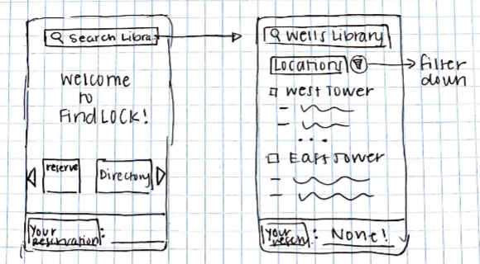
Basic Terminology
Concept Sketches / Use Cases (not shown) / Low-Fidelity Paper Prototypes
Notes:
In human-centered design, designing with the user in mind is central.
We use personas, storyboards, etc. to better address their needs. However, there is only so much we can learn using these tools. It is impossible to have all the answers. In the end of the day, users are the experts of their experiences
Co-design sessions bring the designer closer to their target users.
The two terms Co-design and participatory design are often used interchangeably. But they are different design approaches. Co-design gives more design decision power to users.

Slide 3
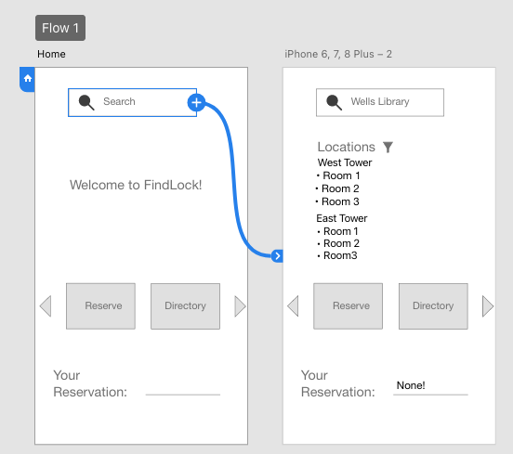
Basic Terminology
Concept Sketches / Use Cases (not shown) / Low-Fidelity Paper Prototypes
Wireframe Digital Prototype
Notes:
In human-centered design, designing with the user in mind is central.
We use personas, storyboards, etc. to better address their needs. However, there is only so much we can learn using these tools. It is impossible to have all the answers. In the end of the day, users are the experts of their experiences
Co-design sessions bring the designer closer to their target users.
The two terms Co-design and participatory design are often used interchangeably. But they are different design approaches. Co-design gives more design decision power to users.

Slide 4
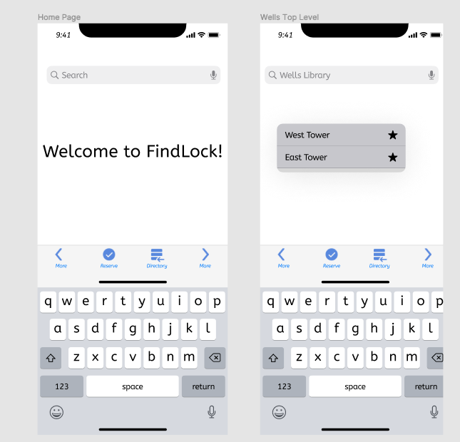
Basic Terminology
Concept Sketches / Use Cases (not shown) / Low-Fidelity Paper Prototypes
Wireframe Digital Prototype
High-Fidelity Digital Prototype
Notes:
In human-centered design, designing with the user in mind is central.
We use personas, storyboards, etc. to better address their needs. However, there is only so much we can learn using these tools. It is impossible to have all the answers. In the end of the day, users are the experts of their experiences
Co-design sessions bring the designer closer to their target users.
The two terms Co-design and participatory design are often used interchangeably. But they are different design approaches. Co-design gives more design decision power to users.

Slide 5
Figma Tutorial

Slide 6
Design Exercise: Digital Prototyping

Slide 7
Exercise: digital prototyping
30 minutes to create digital prototype
2 minutes presenting your prototype to the class

Slide 8
Prototype a Mobile App for Coffee Shop
The coffee shop allows you to buy the following drinks:
Coffee: Drip coffee, Latte, Tea: Earl Grey, Green Tea, or Chai
Hot chocolate
Sugar and/or milk may be added to any drink at no extra charge
Drinks come in 3 sizes (12oz, 16oz, and 20oz, for $2, $3, and $3.50 respectively)
Payment is by cash or credit card. Change is provided for cash transactions
As a group, quickly create a paper prototype for a mobile app for users to order drinks with these constraints
Requirement:
least 3 FULL screens
at least ONE screen with navigation/menu (either on-screen or a drop-down)
at least 1 pop-ups
at least 2 "buttons" on each screen that someone could interact with
anything else you want
make sure your screens are connected

